Slide 1

A platform to collect data on seniors lifestyle, nutrition and cognitive health

Slide 2

Our RETIgoal
To improve the daily activity of senior and MCI patients by offering evidence-based interventions and screening tools to monitor and track disease progression
01
As AD prevalence advances, there is growing demand for preventative tools to increase patient adherence to healthy lifestyle choices
02
As new disease-modifying therapies become available we need to be ready to coordinate care delivery by identifying patients who will benefit
03
Increasing the accessibility to screening, diagnostic and management tools for the aging population to take ownership of their health progression

Slide 3
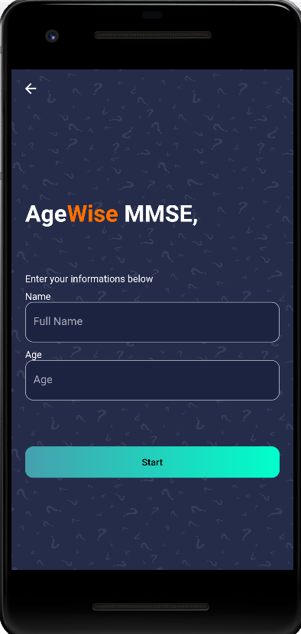




Our Solution
Digital MMSE Test
Food Image Recognition
Digitized cognitive screening tool
Instant nutrition and calorie estimates from the snap of a photo
Social & Food Locator
AD Audio
Detector
Enable geo-location tracking and find nearest healthy restaurants & social events
Integrated into the MMSE questionnaire, audio recognition to detect Parkinson's applied to AD

Slide 4

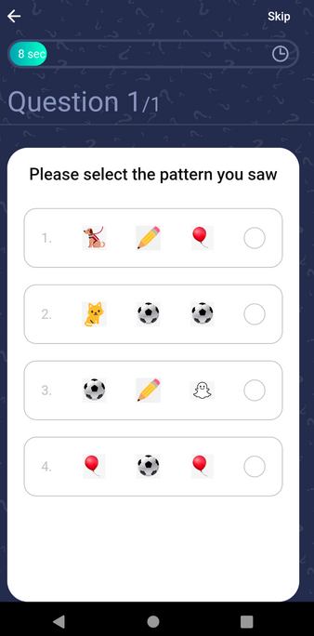
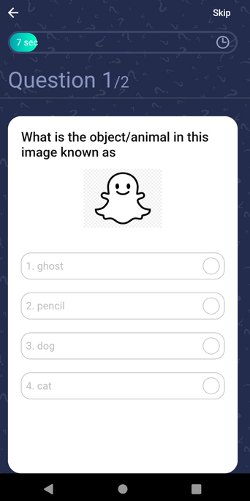
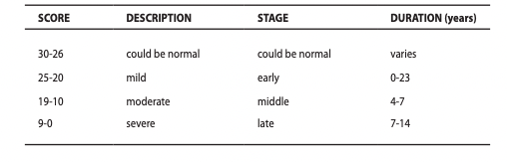
MMSE Screening Feature
01
12 questions scored out of 30 to assess ADL, communication & memory
02
Based on standardized MMSE test
03
Q4 - Audio recognition to identify parkinson disease. Apply same model to Alzheimer's
Add your idea here
Stages of Cognitive Impairment as defined by MMSE scores

Slide 5
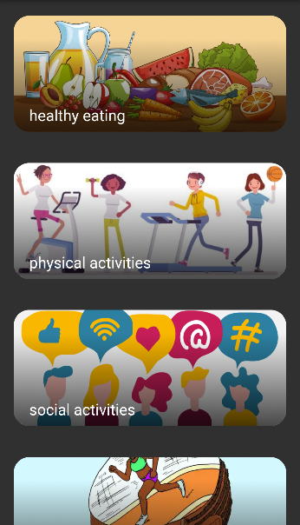



Wellness Component
Targeting the top lifestyle risk factors associated with neurodegenerative decline
An all-in-one platform to monitor activities of daily living, brain health education & promotion
Food recognition feature to easily identify caloric intake
Access brain games, join social events, track fitness metrics and access health records
Pre and post screening test access to lifestyle features
Improve food, fitness, and social exposure
Next steps (clinical diagnosis, enrolment, geo-location clinics)
Add your idea here

Slide 6

AgeWise will offer day-to-day management post MMSE screening
Value for Patient
Provide accessible cognitive screening tool from the comfort of one's home
Fun and easy way to track food, health and cognitive metrics
Provide actionable steps to adopt new lifestyle habits

Slide 7
AgeWise's value-proposition for RetiSpec
Expand service offering to include digital cognitive screening tools
Continuous monitoring: increase patient touchpoint along clinical journey
Acquire MMSE score (potential to increase accuracy of the models)
Opportunity for longitudinal data and re-evaluations
Build brand awareness by promoting brain health education and preventative activity
Provide evidence-based lifestyle interventions to expand our outreach to patients & clinics
Referral to RetiSpec clinics or studies broaden the recruitment funnel
Bridging Awareness and Action

Slide 8
Regulatory
When it comes to data security, we will have to be HIPAA compliant (Health Insurance Portability and Accountability Act) under US regulations and PIPEDA (Personal Information Protection and Electronic Documents Act) in Canada
01
To guarantee high-quality care for the patients we will have to ensure we are protecting valuable patient information
02
As a future feature we would like to also provide Reti scan images for patients to view. We will need to ensure encryption and backup of data to prevent breach or data loss

Slide 9
DEMO

Slide 10
Clinical Ops - UX/UI DESIGNS
01
UX/UI Patient
UX/UI Operator
Large icons & clear instructions
Fast and simple data logging
Minimal additional training
Few design modifications
Simple & easy navigation
Minimalistic Design
Patient UX has been designed to be senior-friendly (< 10 minutes)
MMSE to be logged by the operator into the current operator interface
System setup, updates & data collection will be run by the R&D team
Jen to debrief operators on additional data required & purpose for updates
The application can add another form of data to our hyperspectral images which can be useful for our final goal.
R&D team will add the ability to input the patient's MMSE score into the current operator interface
Weekly time commitment: ~2 hrs/wk - ~10-20 hrs/wk
Weekly time commitment: ~30 min/wk - ~10-20 hrs/wk

Slide 11
Integrating into the RetiSpec Workflow
New Hires:
Software dev team to create commercial-ready app
Post-close of funds
Jen
Initiate training for Operators on new features of data interface
Jen & Carley to assist patients with onboarding
R&D Team
Analyze new data and impact on model
Jen
Manage data entry & compliance
R&D
Operator system set-up, add MMSE option
Carley-Rose & Catherine
Brainstorm for post-beta tests business strategy. How to implement as an extension to current business model (telehealth to address rural areas, community-based approach to alleviate primary care bottlenecks)
Beta Launch within Study Clinics
Anshul to lead.
Carley-Rose & Jen to log complaints/logistics with operators

Slide 12

Implementation
A naive model to analyze the speech signal and provide users with score for that.
An AI model to give scores the pattern drawn by participants.
An AI model to find macros in the image of a meal.

Slide 13
Future Work (Product Roadmap) future
Using API to make predictions and use them in the application.
Making RDS or Firebase connection to save data.
Finish the implementation of permission requirement for camera and microphone.
Release the application for beta-testers to improve it.

